Slide 1



Slide 2
Baglioni Hotels Collection
 | Baglioni Hotel Carlton, Milan
 | Baglioni Hotel Luna, Venice
 | Relais Santa Croce, Florence
 | Baglioni Hotel Cala del Porto, Punta Ala - Tuscany
 | Baglioni Hotel Regina, Rome
 | Baglioni Hotel, London
 | Villa Gallici, Aix-en-Provence
 | Le Saint Paul, Saint Paul de Vence
 | Baglioni Resort Maldives – NEXT OPENING
L
L
L
L
L

Slide 3
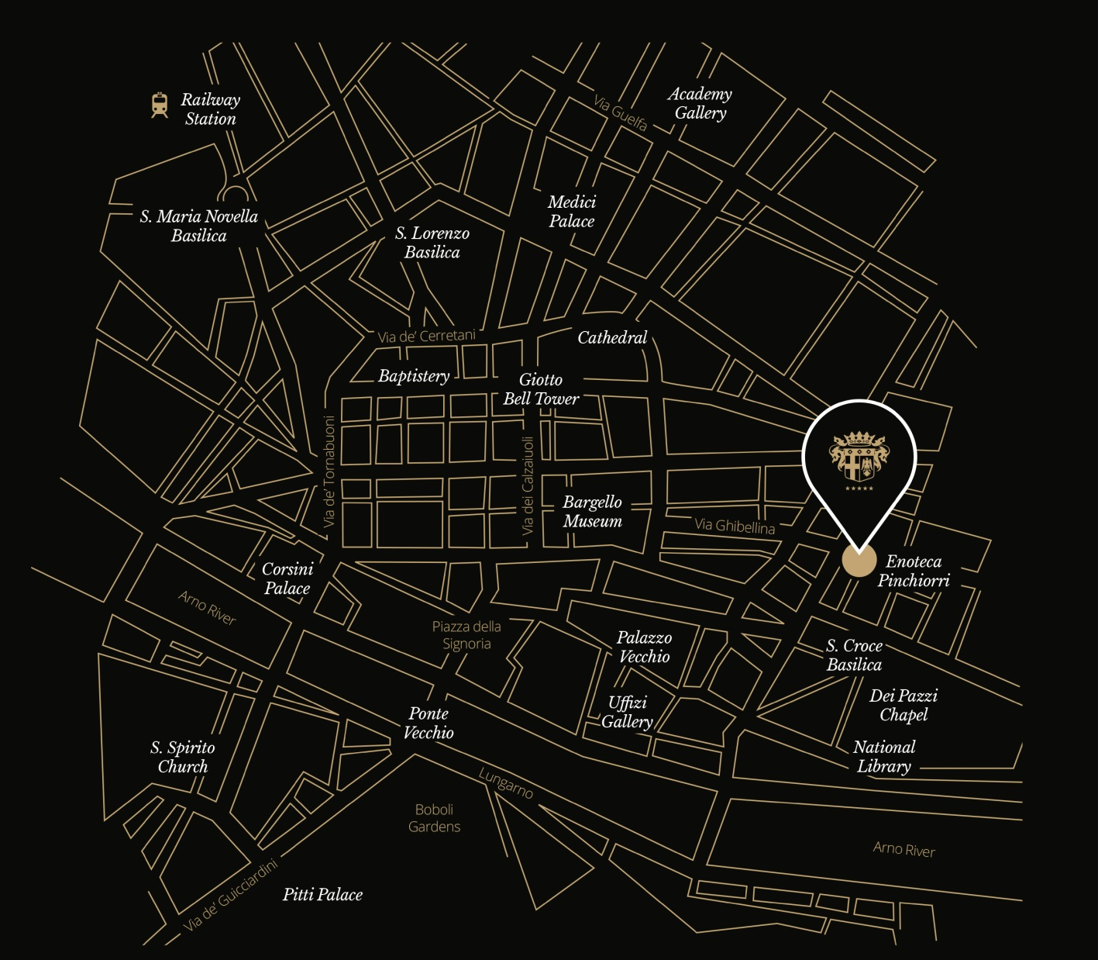

RELAIS SANTA CROCE
Via Ghibellina 87
50122 Florence - Italy
ph. +39 055 2342230
www.baglionihotels.com/Florence
YOUR DEDICATED MEETING PLANNER
Ph. +39 055 2342230
Email: events.santacrocefirenze@baglionihotels.com
How to get there:
By air
The Florence A. Vespucci Airport is 9 km from the hotel.
By train
Florence’s Santa Maria Novella Railway Station is
3 km from the hotel.

Slide 4
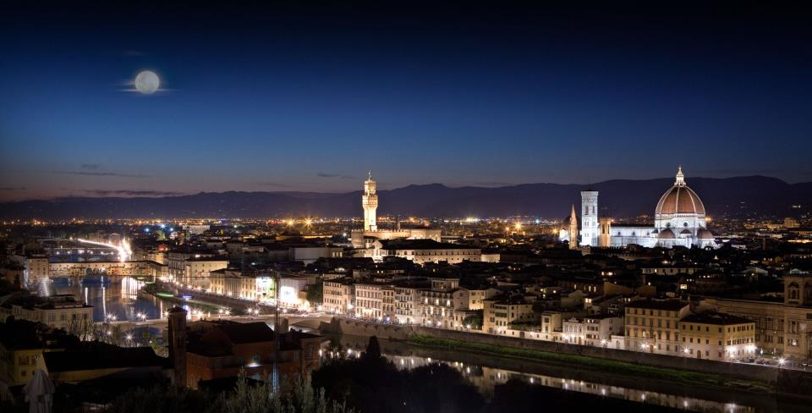

Slide 5
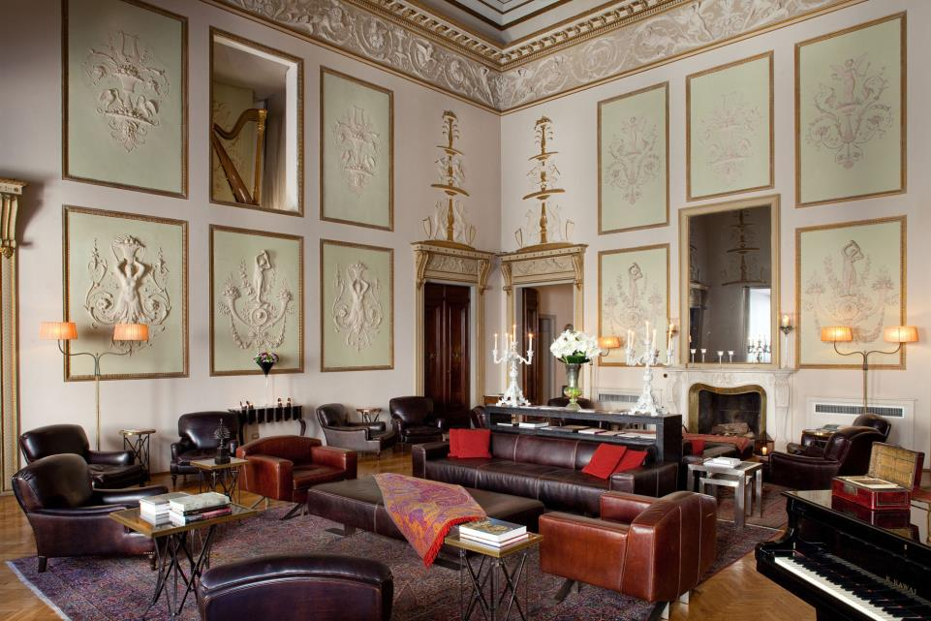
Music Hall

Slide 6
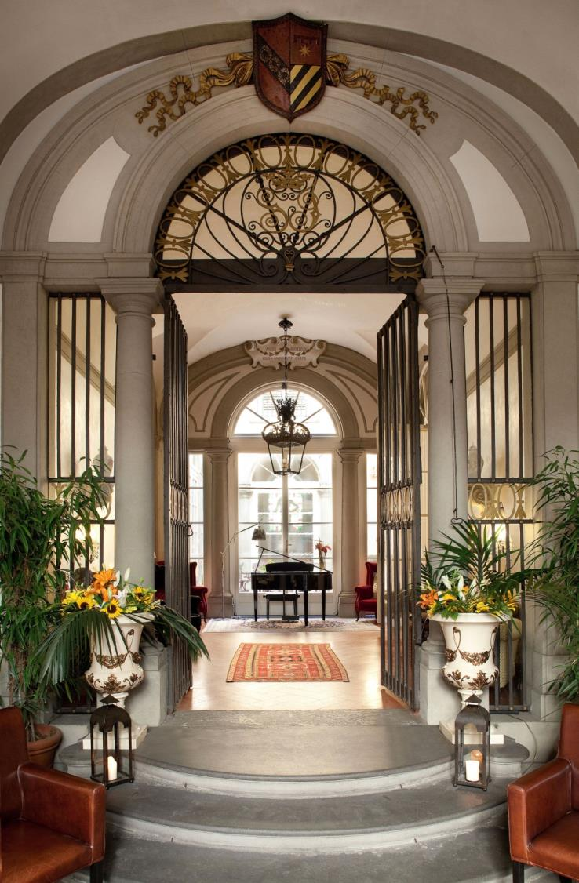
ACCOMMODATION
The stunning 18th century Palazzo Ciofi-Jacometti, once owned by the Marquis Baldinucci treasurer to the Pope, is home to this exclusive hotel in the heart of Florence, associated Relais & Châteaux.
Overlooking the rooftops of Florence, the Duomo and Santa Croce Basilica, the 24 splendid rooms and suites of Relais Santa Croce offer guests high quality comfort and luxury services.
12 Rooms
9 Deluxe Rooms
3 Grand Deluxe Rooms
12 Suites
6 Junior Suites
4 Suites
1 Presidential Suites
1 Royal Suite
Exclucisve use
The Palazzo can be hired for exclusive stylish private parties, meetings and promotional events with total privacy
guaranteed. Our friendly and attentive staff will be happy to treat you and your guests to the highest levels of service to
create a memorable event!

Slide 7
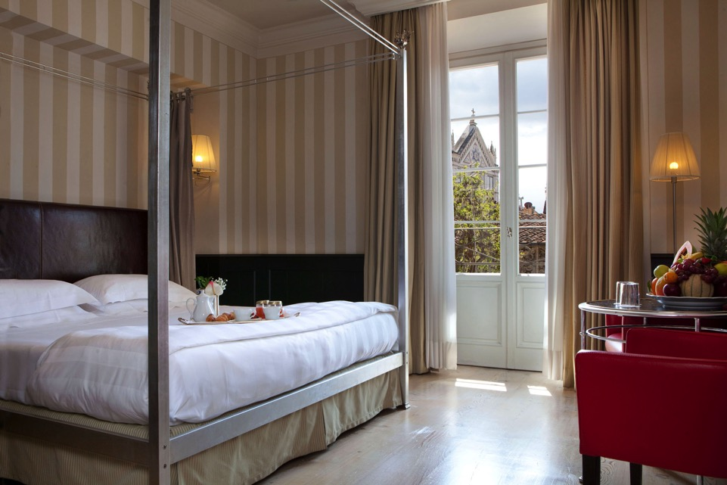
Deluxe Room

Slide 8
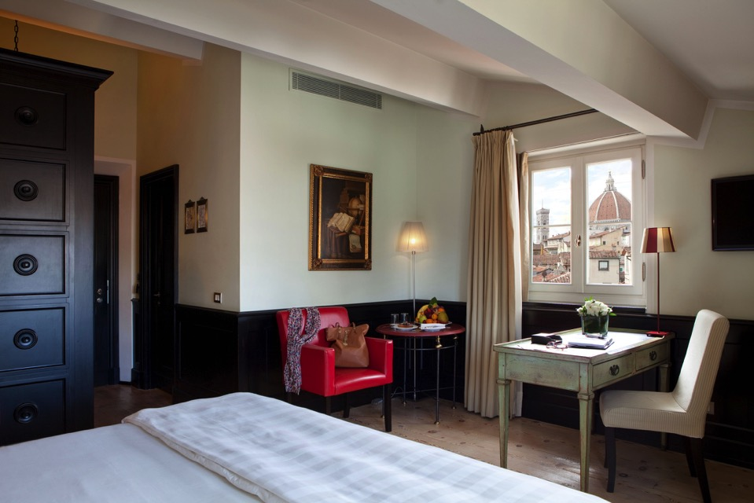
Grand Deluxe Room

Slide 9
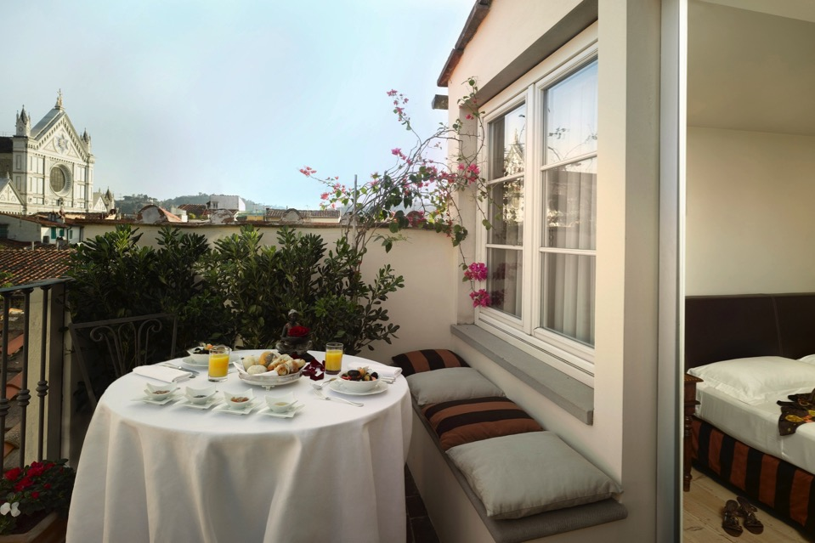
Junior Suite

Slide 10
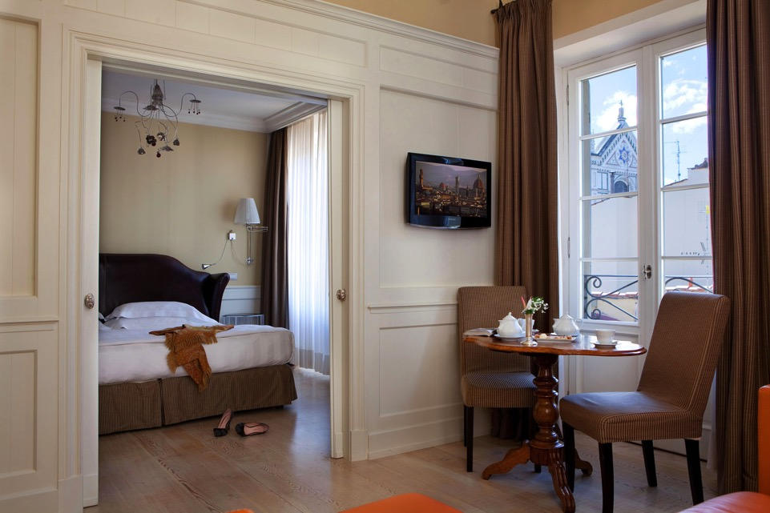
Suite

Slide 11
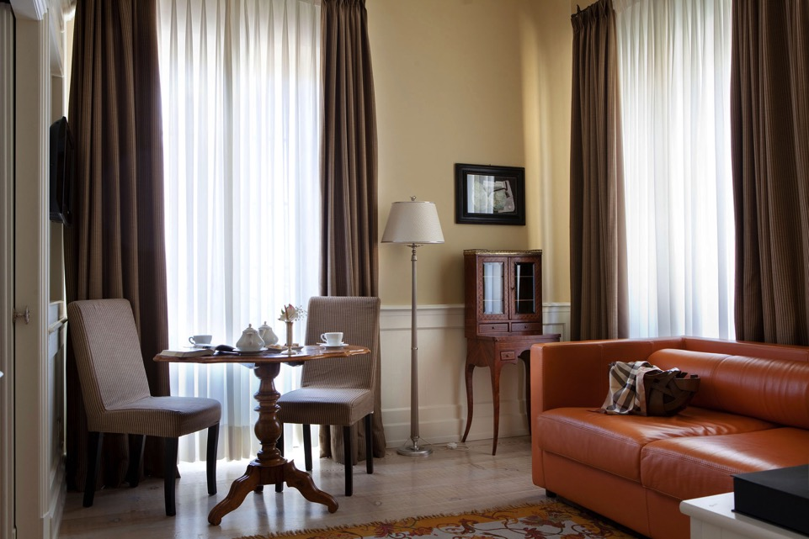
Suite

Slide 12
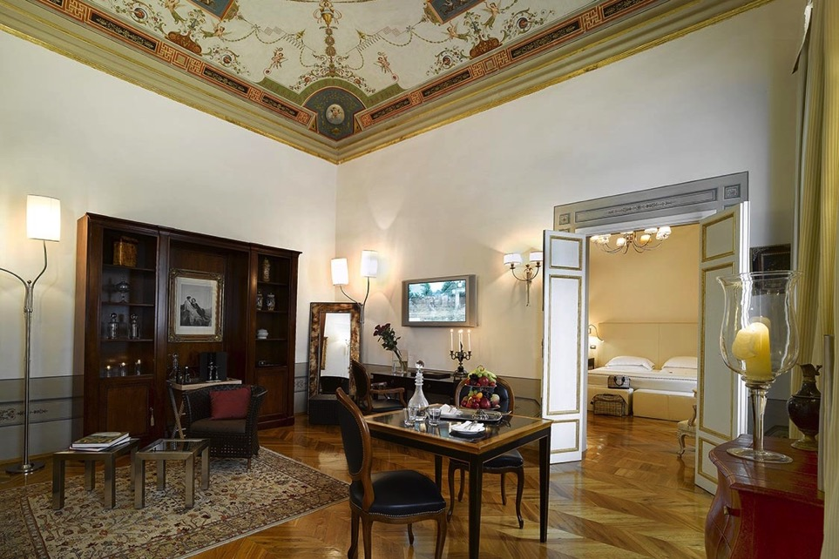
De Pepi Suite

Slide 13
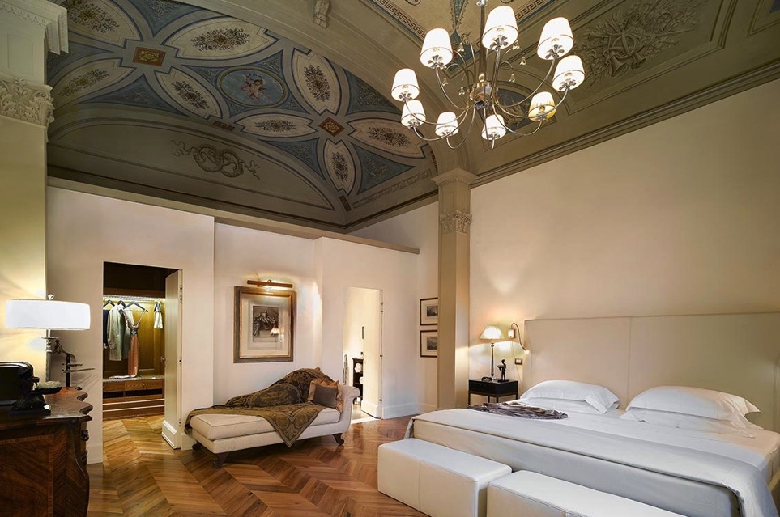
De Pepi Suite

Slide 14
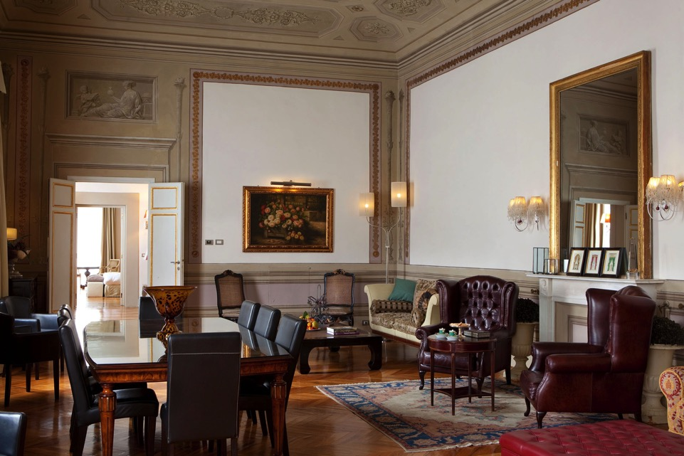
Da Verrazzano Suite

Slide 15
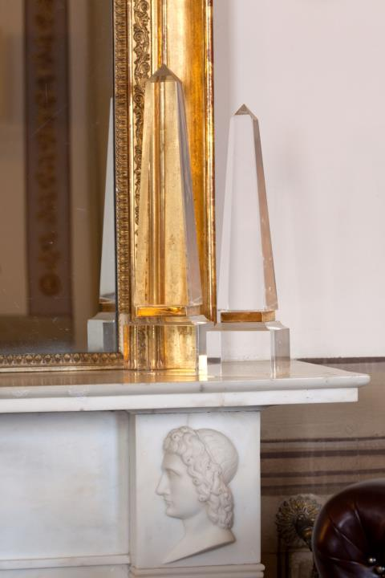
GUELFI & GHIBELLINI RESTAURANT
The Guelfi & Ghibellini restaurant excels in Mediterranean cuisine with a strong emphasis on Tuscan flavours; a perfect way
to experience traditional local specialities and contemporary variations. The three Michelin star Enoteca Pinchiorri, in the
same Palazzo, rounds off the gastronomic experience with its fine cuisine and world-renowned wine cellar.

Slide 16
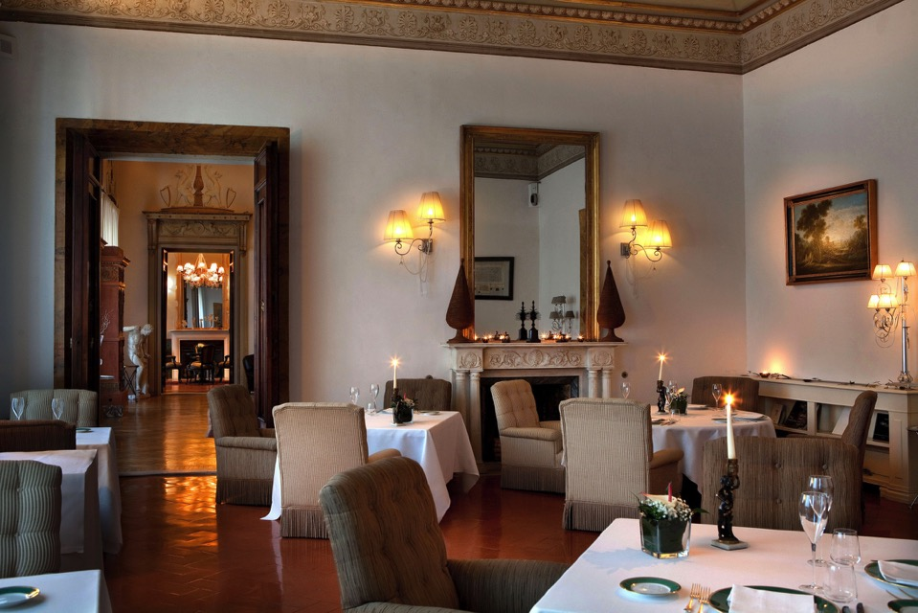
Guelfi e Ghibellini restaurant

Slide 17
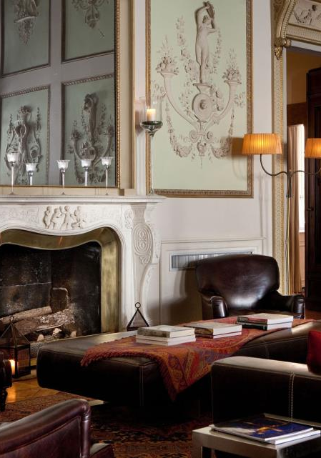
MEETING & EVENTS
Relais Santa Croce has functions rooms for meetings and events for up to 150 people that combine old-world luxury and contemporary comfort. With its evocative
and versatile venues, it is the perfect choice for fairy-tale weddings, private parties, business meetings, conferences and prestigious corporate events.

Slide 18




MEETING ROOMS DIMENSIONS AND CAPACITIES
 | sqmt | sqft |  |  |  |  |  | Floor
Music Room | 113 | 1216 | 30 | 100 | 60 | 150 | 80 | 1
Fumoir | 25 | 269 | 10 | 20 | 10 | 15 | 10 | 1
Baldinucci Room | 50 | 538 | 20 | 40 | 25 | 50 | 32 | 1
Guelfi & Ghibellini Restaurant | 56 | 603 | - | - | - | 50 | 40 | 1

Slide 19
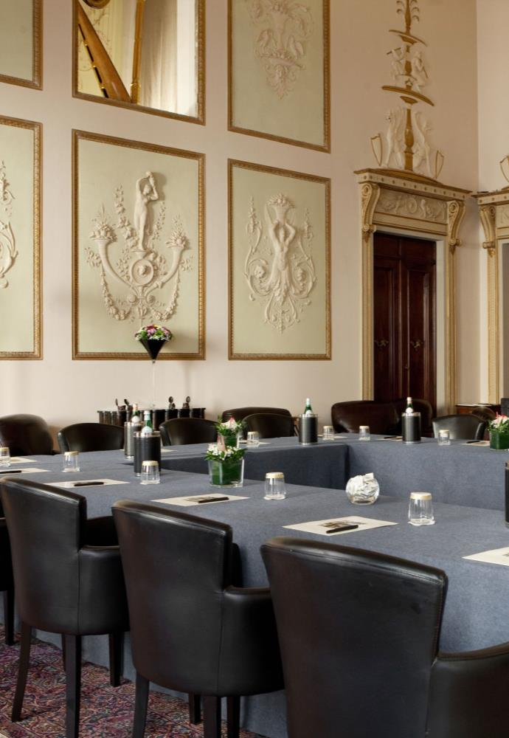
MUSIC ROOM
Situated on the magnificent first floor, the Sala della Musica is a majestic ballroom with a stately ambiance
that can host up to 150 guests. An imposing fireplace, high frescoed ceilings and large windows that bathe the room in natural light create an all-embracing feeling of grandeur and a timeless, magical setting.
A stunning 3-metre crystal chandelier was suspended from the ceiling by wooden trusses based on a Leonardo da Vinci design that are still visible today. The Sala della Musica is the perfect venue for meetings, corporate events, press conferences, theatrical performances and private concerts.

Slide 20
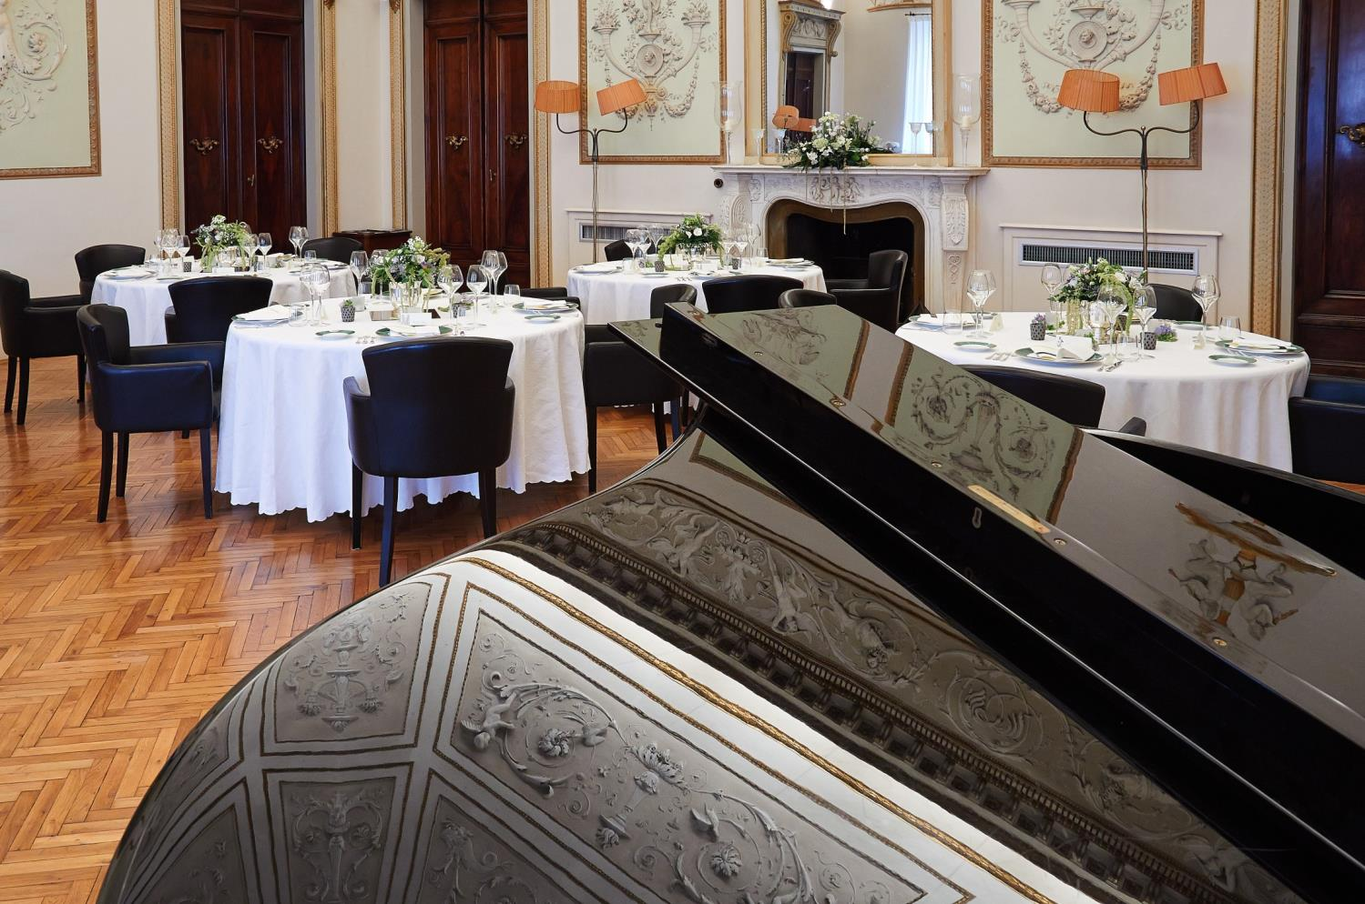

Slide 21
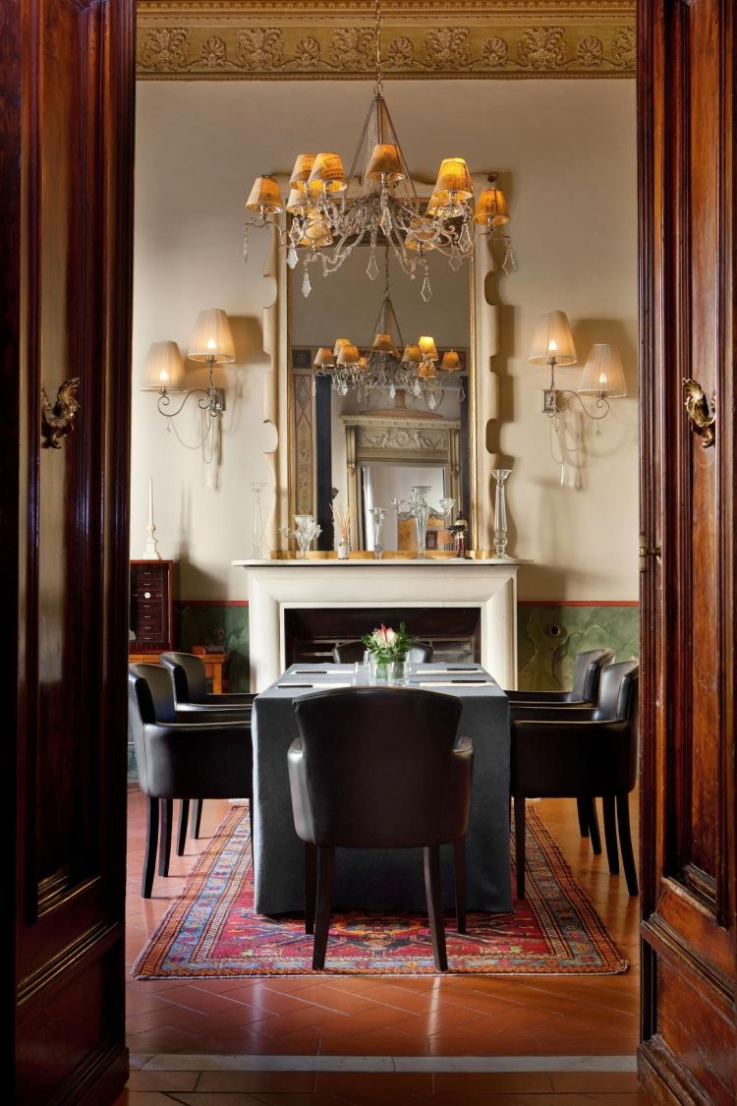
FUMOIR
A refined retreat for those wishing to enjoy a cigar and conversation the Fumoir, based on the design for a 1930s smoking room, is a cosy salon ideal for small gatherings or private dinners for up to 20 guests.

Slide 22
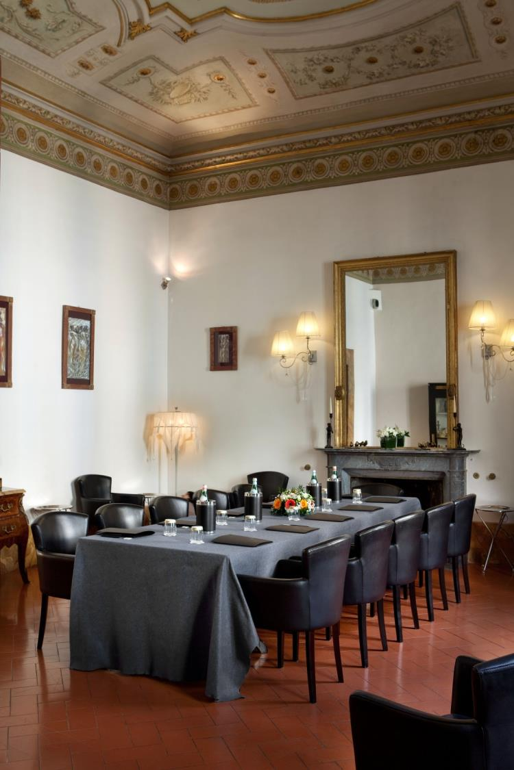
BALDINUCCI ROOM
The hotel has cosy, versatile spaces for intimate business meetings. The Sala Baldinucci is an elegant reception room that can accommodate up to
50 people.

Slide 23
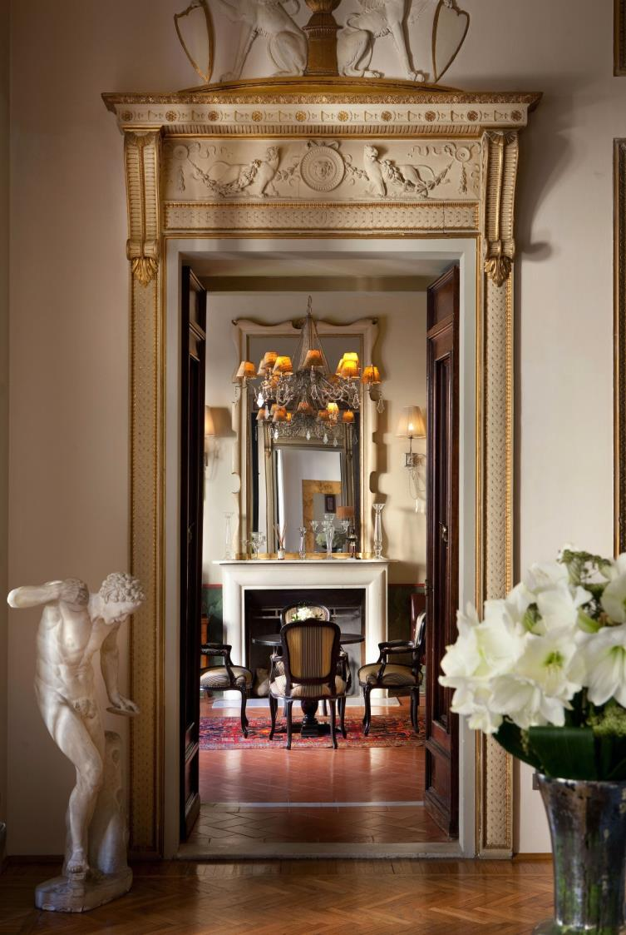
TECHNICAL EQUIPMENT INCLUDED:
Flip chart
High-speed internet connection
Audio visual equipment
Video projector and screen
ON REQUEST
Full-time technical assistance
Secretarial service
Audio and video recording
Simultaneous translation service
Video-conferencing
CATERING OPTIONS:
Welcome coffee/drink
Coffee breaks
Cocktail
Working lunches
Gala dinners
Banquets
YOUR DEDICATED MEETING PLANNER:
Ph. +39 055 2342230
email: events.santacrocefirenze@baglionihotels.com

Slide 24
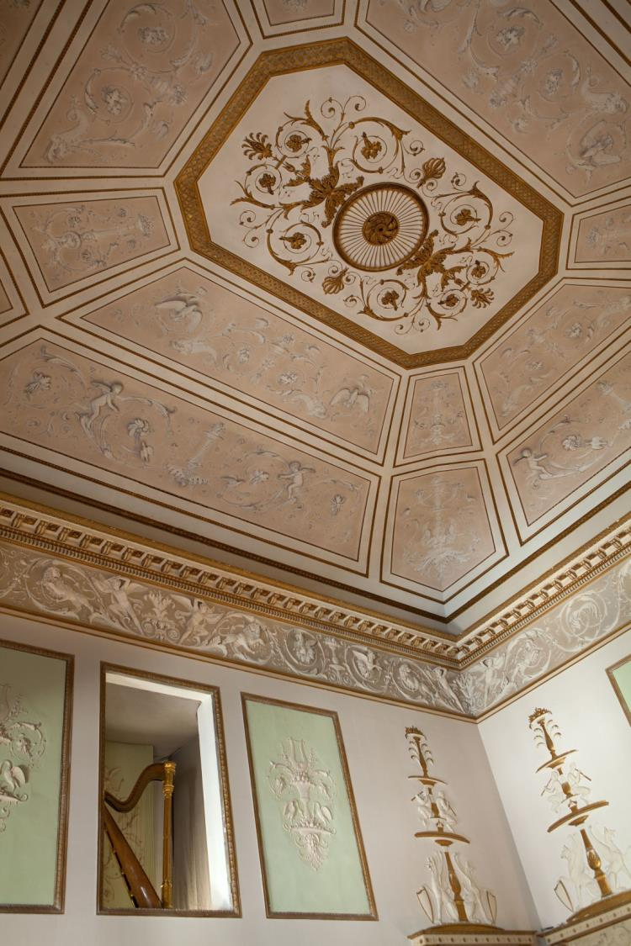
EXCLUSIVELY YOURS
Relais Santa Croce can be rented for exclusive use upon request for celebrations, incentive and
private gatherings.
Dedicated benefits:
Welcome drink with canapé served in our splendid Sala della Musica
Gourmet Buffet breakfast at our elegant restaurant “Guelfi & Ghibellini”
VIP Treatment and in-room special gift upon arrival
Free Internet for the entire stay for all guests
Our Staff will be pleased to assist you in organizing exclusive services in Florence and around Tuscany:
Food and Wine tasting
Cooking classes
Exclusive cultural tours
Exclusive tours in Chianti by: Vespa motorbike, Fiat 500, bike and others
Race cars at Ferrari’s track Mugello

Slide 25
Grazie
#RelaisSantaCroce
The Blog: italiantalks.com
www.baglionihotels.com/florence

